Slide 1
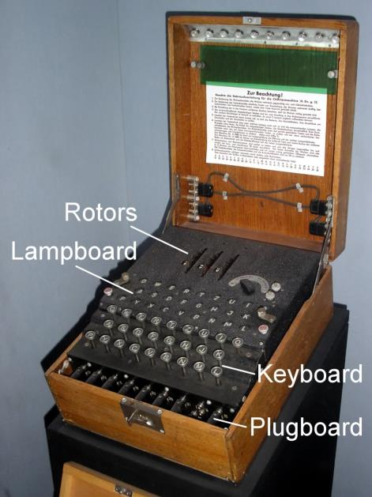
Enigma: Old machine for encryption
Notes:
Enigma machine

Slide 2
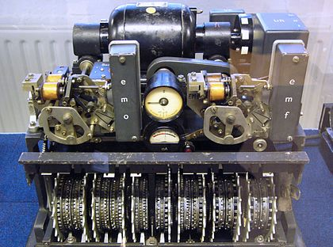
Lorenz: Old machine for encryption
Notes:
Picture: Lorenz SZ42 machine
Source: Wikipedia
Used by: German Army in WWII
Note: More sophisticated than the Enigma code
This was the reason the Colossus computer was built

Slide 3
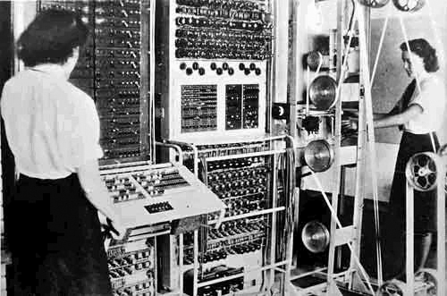
Photo of an old computer
Notes:
Name: Colossus
World’s first: electronic digital programmable computer
Colossus
Mark I contained 1500 thermionic valves (tubes)
Mark II contained 2400 valves – 5x faster and simpler to operate than Mk I

Slide 4
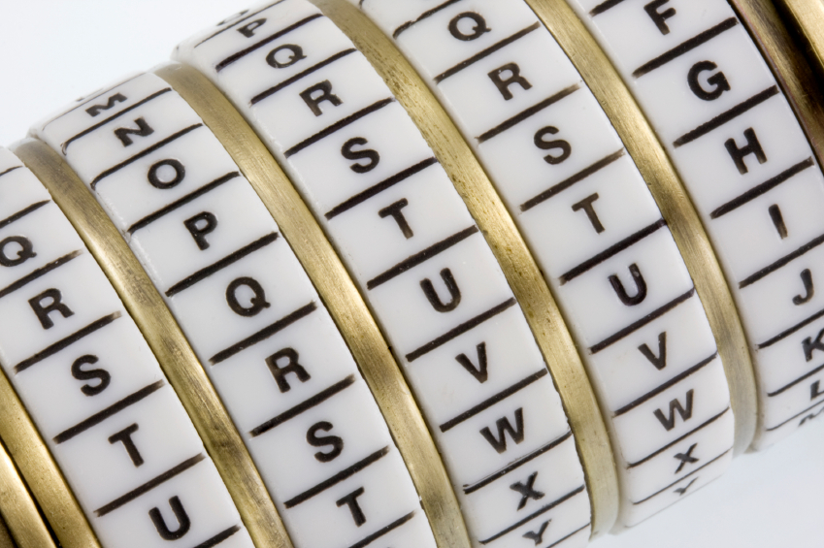
Cryptography
Corporate Computer Security, 4th Edition
Randall J. Boyle & Raymond R. Panko
Chapter 3

Slide 5
Learning Objectives
Explain the concept of cryptography.
Describe symmetric key encryption and the importance of key length.
Explain negotiation stage.
Explain initial authentication, including MS-CHAP.
Describe keying, including public key encryption.

Slide 6
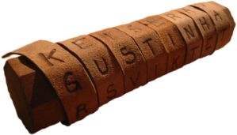
Introduction
Some Early History:
1900 BC: Egyptians use non-standard hieroglyphics
475 BC: Spartans of Greece develop the scytale
50 BC: Julius Caesar using a simple cipher for military and government communications.
725 AD: Abu `Abd al-Rahman al-Khalil ibn Ahmad ibn `Amr ibn Tammam al Farahidi al-Zadi al Yahmadi wrote a (now lost) book on cryptography
1466 AD: Leon Battista Alberti, the Father of Western cryptography worked on polyaphabetic substitution and a ciper disk.
1623 AD: Sir Francis Bacon described one of the first uses of steganography

Slide 7




3.1: Cryptography
Cryptography is the use of mathematical operations to protect messages traveling between parties or stored on a computer
Confidentiality means that someone intercepting your communications cannot read them
???

Slide 8
3.1: Cryptography
Confidentiality is only one cryptographic protection
Integrity means that the message cannot be changed or, if it is change, that this change will be detected
Authentication means proving one’s identity to another so they can trust you more
Known as the CIA of cryptography

Slide 9
3.1: Cryptography
Encryption for confidentiality needs a cipher (mathematical method) to encrypt and decrypt
The cipher cannot be kept secret
The two parties using the cipher also need to know a secret key (or keys)
A key is merely a long stream of bits (1s and 0s)
The key (or keys) must be kept secret
Cryptanalysts attempt to crack (find) the key

Slide 10
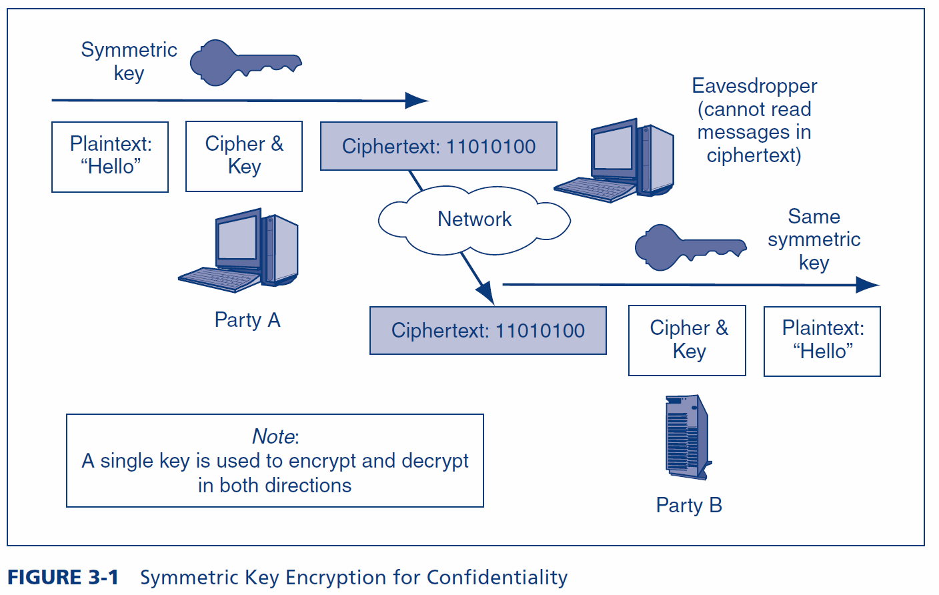
3.1: Symmetric Key Encryption for Confidentiality

Slide 11
3.1: Example Symmetric Key Cipher (Fig. 3-2)
Plaintext | Key | Ciphertext
n | 4 | r
o | 8 | w
w | 15 | l
i | 16 | …
s | 23 | …
t | 16 | …
h | 3 | …
e | 9 | …
t | 12 | …
i | 20 | …
m | 6 | …
e | 25 | …
+4
n o p q r
This is a very weak cipher.
Real ciphers use complex math.

Slide 12
3.1: Types of Ciphers
Substitution Ciphers
Substitute one letter (or bit) for another in each place
The cipher we saw in Figure 3-2 is a substitution cipher
Transposition Ciphers
Transposition ciphers do not change individual letters or bits, but they change their order
Most real ciphers use both substitution and transposition

Slide 13
3.1: Transposition Cipher
 | Key (Part 1)
Key (Part 2) | 1 | 3 | 2
2 | n | o | w
3 | i | s | t
1 | h | e | t
Key = 132 231

Slide 14
3.1: Ciphers versus Codes
Ciphers can encrypt any message expressed in binary (1s and 0s)
This flexibility and the speed of computing makes ciphers dominant for encryption today
Codes are more specialized
They substitute one thing for another
Usually a word for another word or a number for a word
Codes are good for humans and may be included in messages sent via encipherment

Slide 15
3.1: Key Length and Exhaustive Search Time
Key Length in Bits | Number of Possible Keys
1 | 2
2 | 4
4 | 16
8 | 256
16 | 65,536
40 | 1,099,511,627,776
56 | 72,057,594,037,927,900
112 | 5,192,296,858,534,830,000,000,000,000,000,000
112 | 5.1923E+33
168 | 3.74144E+50
256 | 1.15792E+77
512 | 1.3408E+154
Each extra bit
doubles the number of keys
Shaded keys are
Strong symmetric keys (>=100 bits)

Slide 16
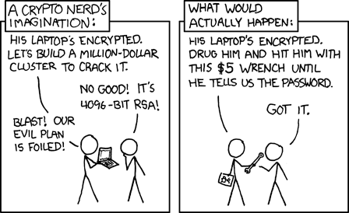
Exhaustive Search vs. Weakest Link
Notes:
Cartoon: XKCD.com

Slide 17
3.1: Key Length and Exhaustive Search Time
Public key/private key pairs (discussed later in the chapter) must be much longer than symmetric keys to be considered to be strong because of the disastrous consequences that could occur if a private key is cracked and because private keys cannot be changed frequently.
Public keys and private keys must be at least 512 to 1,024 bits long.

Slide 18
3.2: Major Symmetric Key Encryption Ciphers
 | RC4 | DES | 3DES | AES
Key Length (bits) | 40 bits or more | 56 | 112 or 168 | 128, 192, or 256
Key Strength | Very weak at 40 bits | Weak | Strong | Strong
Processing Requirements | Low | Moderate | High | Low
RAM Requirements | Low | Moderate | Moderate | Low
Remarks | Can use keys of variable length | Created in the 1970s | Applies DES three times with two or three different DES keys | Today’s gold standard for symmetric key encryption

Slide 19
3.3: Cryptographic System Stages
Cryptographic Systems
Encryption for confidentiality is only one cryptographic protection
Individual users and corporations cannot be expected to master these many aspects of cryptography
Consequently, crypto protections are organized into complete cryptographic systems that provide a broad set of cryptographic protection

Slide 20
3.3: Cryptographic System Stages
Cryptographic Systems
Two parties first agree upon a particular cryptographic system to use
Each cryptographic system dialogue begins with three brief handshaking stages
The two parties then engage in cryptographically protected communication
This ongoing communication stage usually constitutes nearly all of the dialogue

Slide 21
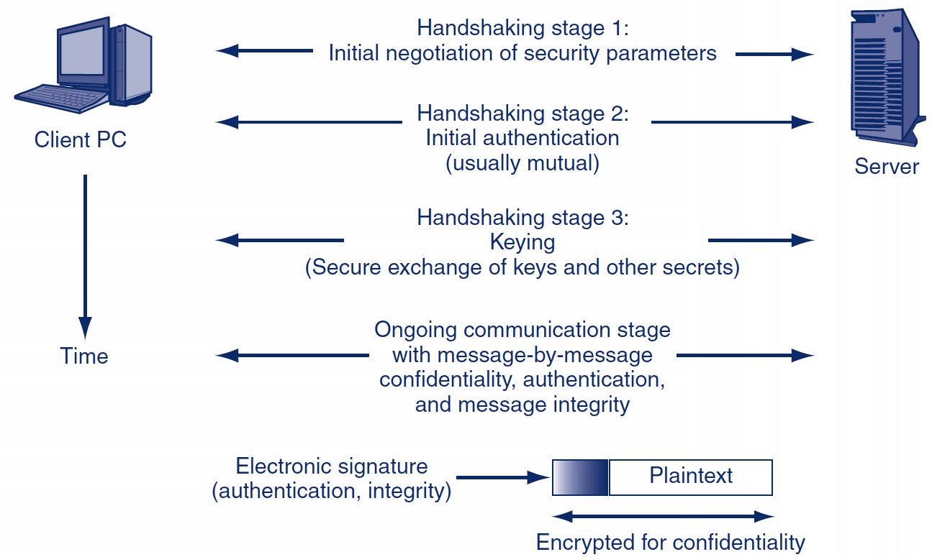
3.3: Cryptographic System Stages

Slide 22
Stage 1: Selecting Security Methods and Parameters
Selecting methods and parameters
Authentication
Keying (the secure exchange of secrets)
Ongoing communication

Slide 23
3.4: Selected SSL/TLS Cipher Suites
Cipher Suite | Key Negotiation | Digital Signature Method | Symmetric Key Encryption Method | Hashing Method for HMAC | Strength
NULL_WITH_NULL_NULL | None | None | None | None | None
RSA_EXPORT_WITH_ RC4_40_MD5 | RSA export strength (40 bits) | RSA export strength (40 bits) | RC4 (40-bit key) | MD5 | Weak
RSA_WITH_DES_CBC_ SHA | RSA | RSA | DES_CBC | SHA-1 | Stronger but not very strong
DH_DSS_WITH_3DES_ EDE_CBC_SHA | Diffie-Hellman | Digital Signature Standard | 3DES_ EDE_CBC | SHA-1 | Strong
RSA_WITH_AES_256_CBC_SHA256 | RSA | RSA | AES 256 bits | SHA-256 | Very strong

Slide 24
Stage 2: Authentication
Selecting methods and parameters
Authentication
Keying (the secure exchange of secrets)
Ongoing communication

Slide 25
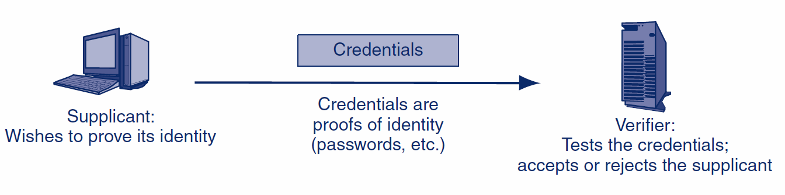
3.5: Authentication: Supplicant, Verifier, and Credentials

Slide 26
3.5: Hashing
Hashing
A hashing algorithm is applied to a bit string of any length
The result of the calculation is called the hash
For a given hashing algorithm, all hashes are the same short length
Hashing
Algorithm
Bit string of any length
Hash: bit string of small fixed length

Slide 27
3.5: Hashing
Hashing versus Encryption
Characteristic | Encryption | Hashing
Result length | About the same length as the plaintext | Short fixed length regardless of message length
Reversible? | Yes. Decryption | No. There is no way to get from the short hash back to the long original message

Slide 28
3.5: Hashing
Hashing Algorithms
MD5 (128-bit hashes)
SHA-1 (160-bit hashes)
SHA-224, SHA-256, SHA-384, and SHA-512 (name gives hash length in bits)
Note: MD5 and SHA-1 should not be used because they have been shown to be unsecure

Slide 29
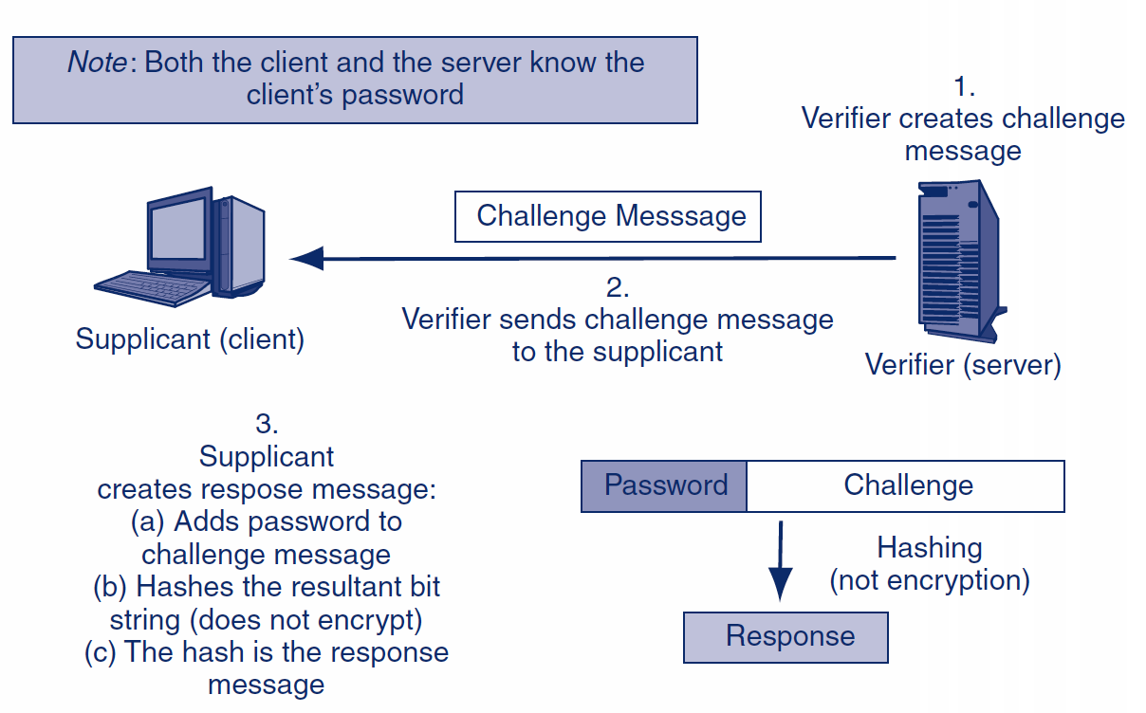
3.5: MS-CHAP Challenge-Response Authentication Protocol

Slide 30
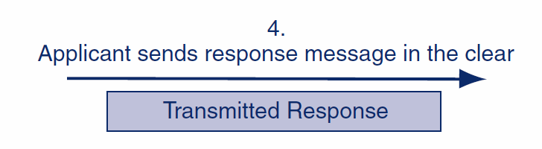
3.5: MS-CHAP Challenge-Response Authentication Protocol

Slide 31
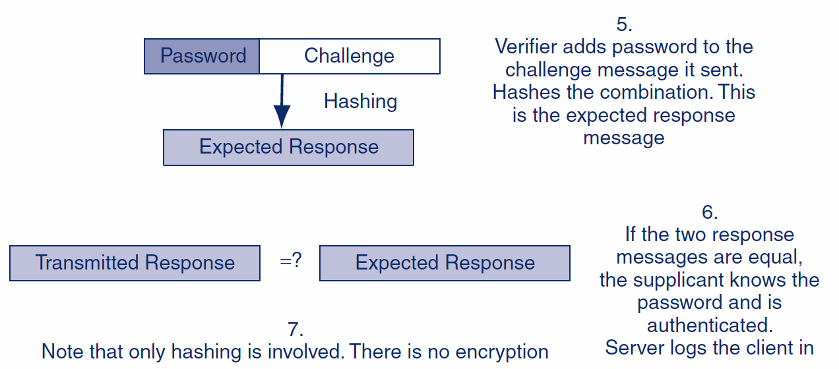
3.5: MS-CHAP Challenge-Response Authentication Protocol

Slide 32
Stage 3: Keying
Selecting methods and parameters
Authentication
Keying (the secure exchange of secrets)
Ongoing communication

Slide 33
3.6: Public Key Encryption for Confidentiality
There are two types of ciphers used for confidentiality
In symmetric key encryption for confidentiality, the two sides use the same key
For each dialogue (session), a new symmetric key is generated: the symmetric session key
In public key encryption, each party has a public key and a private key that are never changed
A person’s public key is available to anyone
A person keeps his or her private key secret

Slide 34
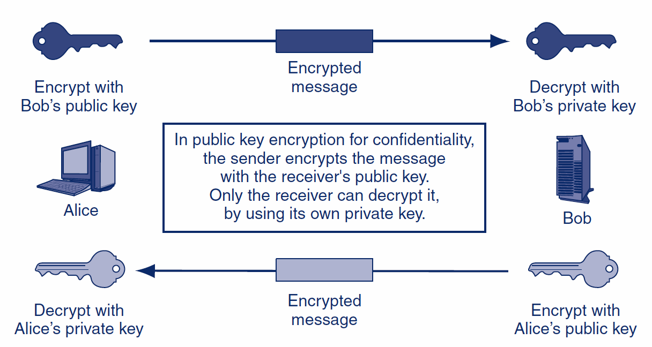
3.6: Public Key Encryption for Confidentiality

Slide 35
Double Edged Swords
Merely communicating in secret can arouse interest and suspicions.
It may be unbreakable, an encrypted message is easy to see and tag.
It could be stored now and broken later…

Slide 36
More Double Edged Swords
It could already be broken e.g. weak algorithm
Yes, it is encrypted, but did the True Party send it?
It could have already been read: MitM attack

Slide 37
Digression: Steganography
The art of “covered” writing
Technically not a form of cryptography
Practice of concealing a file, message, image, or video within another file, message, image, or video.
Why? The double edged sword of cryptography…
Merely communicating in secret can arouse interest and suspicions.
It may be unbreakable, an encrypted message is easy to see and tag.
Notes:
Wikipedia

Slide 38
Digression: Steganography
Cryptography is the practice of protecting the contents of a message,
Steganography is focused on concealing the:
fact that a secret message is being sent
contents of the message.
Notes:
Wikipedia

Slide 39

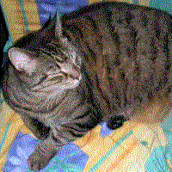
Digression: Steganography
Image of a tree with a hidden image. It is revealed by removing all but the 2 least significant bits of each color component and a subsequent normalization.
The hidden image.
Source: Wikipedia
Notes:
The contents of this slide is from Wikipedia

Slide 40
The End 1st Half of Cryptography

Slide 41
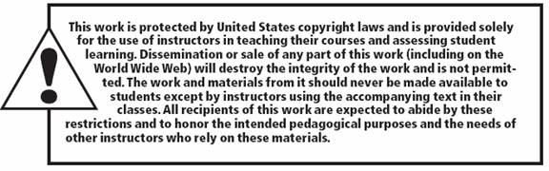
Copy right statement
All rights reserved. No part of this publication may be reproduced, stored in a retrieval system, or transmitted, in any form or by any means, electronic, mechanical, photocopying, recording, or otherwise, without the prior written permission of the publisher. Printed in the United States of America.
Copyright © 2010 Pearson Education, Inc.
Publishing as Prentice Hall

